Slide 1
IMPACT Conjunction and Sidelobe Operations
Janet Luhmann, Dave Curtis, Peter Schroeder, Dick Mewaldt and the IMPACT Team
July 2, 2014

Slide 2
Outline
Instrument Power States in Sidelobes and Conjunction Periods
SSR requirements
First sidelobe telemetry
Second sidelobe telemetry
Science to be done during this period

Slide 3
Instrument Power States
Both sidelobes
Powered on
IDPU/MAG
SEP
MAG heater
SWEA survival heater
Powered off
SWEA/STE-D
Superior Conjunction
IMPACT powered off but MAG heater and survival heaters powered on

Slide 4
SSR Requirements
Store IMPACT beacon (ApID 270, 1 packet/minute)
Total bitrate of 36.3bps
Total volume of ~1.03 Gbits, ~24% of available 4.294 Gbits SSR space for science (dumped after we return to normal operations)
Maybe add some margin in case we don’t get back to operations on schedule.
Just one partition needed.

Slide 5
First Sidelobe Telemetry
At a minimum for monitoring instrument health and safety we need housekeeping (ApID200-203, 240-241, average total housekeeping bitrate 76.2bps) and beacon (ApID270, 36.3bps). Beacon is also being written to the recorder.
In addition, we would like to send some real time science from MAG (ApID208, normally 414bps @ 8 samples/sec) and SEP (ApID244-268, normally 1.3kbps). We can reduce the bitrate by averaging, decimation, and excluding some ApIDs. Tell us what bitrate we can get and we will configure the instrument accordingly.
It would be good to get an allocated bitrate soon so we can divide it amongst the instruments and build and test the corresponding instrument configuration commands.

Slide 6
Second Sidelobe Telemetry
Again, at a minimum for monitoring instrument health and safety we need housekeeping (ApID200-203, 240-241, average total housekeeping bitrate 76.2bps) and beacon (ApID270, 36.3bps). Beacon is also being written to the recorder.
We anticipate reducing science by lowering MAG time resolution and decimating and eliminating other science packet types.
Again, we need to know soon what our allocation will be so we can test the configuration.

Slide 7
Candidate IMPACT Bitrates
White is normal rates, Green are some candidate Sidelobe 1 cases, Blue are some candidate sidelobe 2 cases.

Slide 8
IMPACT Sidelobe Period Science
Main Goal: To recover some of the heliosphere-wide space weather
in-situ observational coverage (mainly MAG and SEP) originally intended
for Far-side Science and planetary mission science support during the
unforeseen period of reduced operations.
Priorities:
Record beacon MAG and SEP data on SSR throughout all sidelobe
periods to provide continuous coverage of conditions on the farside
(excepting periods of superior conjunction when IMPACT will be off).
Real time telemetry of HK and beacon data to monitor instrument
health and obtain snapshots of farside space weather once/day
3. Additional MAG and SEP data as possible within the realtime contacts
-

Slide 9
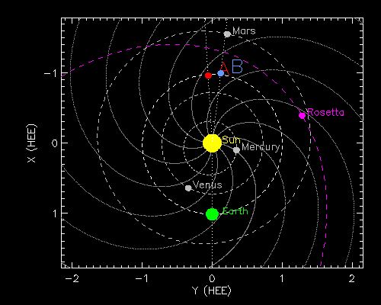
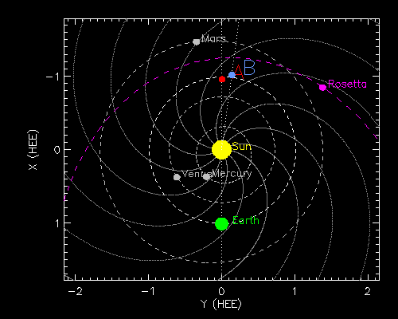
July 1, 2015
Some farside science details:
-MAVEN will be at mid-prime-mission
in mid-2015, and will rely on STEREO
for approaching space weather event
information (realtime) and later for
retrospective event studies (SSR
Beacon data).
-Rosetta will be approaching
perihelion and will be observing the
cometary response to solar wind
conditions, including IMF sector
boundary crossings and ICMEs
May 15, 2015 ‘where’ plot

Slide 10
Farside science with sidelobe and SSR IMPACT data (continued)
-Further SEP event longitudinal spread information
(the topic of an LWS Science Focus) will be obtained
-Trends in interplanetary magnetic field, ICME and SEP events in
this unusual solar cycle will be tracked as solar activity declines
(often considered a phase during which major CMEs occur)
-In-situ support for SWAVES, PLASTIC and SECCHI science
observations
-In-situ support for farside space weather data users (eg. NOAA
SWPC, NASA GSFC)

Slide 11
Note on IMPACT use of extra sidelobe real-time data volume:
>> Allows for more detailed and more continuous IMPACT
health checks during the sidelobe periods
>> Allows for more real-time space weather data coverage
for uses in forecasts and planetary mission needs
>> Allows us to obtain a more substantial sampling of the
sidelobe period-especially in the event the SSR beacon
data cannot, for some reason, be retrieved

